Slide 1
Mileposts and Heroes*
To Lead Us On Beyond the NGSS
A Brief (and idiosyncratic) History of Science Education
OSTA Fall Conference, October 11, 2019 Lane Community College, Eugene, Oregon
Kip Ault, Professor Emeritus
Lewis & Clark Graduate School of Education and Counseling
ault@lclark.edu
www.darwinianwhimsy.com
(Notes and slides may be downloaded from my website.)
*Indicates a hero.

Slide 2
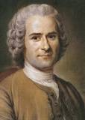
Milepost 1762
Jean-Jacques Rousseau, Emile, or On Education
“The first time a child sees a stick dropped halfway in water, he sees a broken stick. . . . To know if it is broken, as it appears to be, how many things must we do before drawing it from the water or putting a hand to it?”
“The things a child says are not what they are to us; the child does not attach the same ideas to them.”

Slide 4
Milepost 1854
Thomas Huxley, The Educational Value of the Natural Sciences
“The methods of all sciences are identical; and these are:”
Observation of facts—including artificial observation which is called experiment.
General propositions—tying up similar facts into bundles called comparison and classification.
Deduction—making inferences from the general propositions.
Verification—process of ascertaining whether an anticipation [inference] is correct.

Slide 5
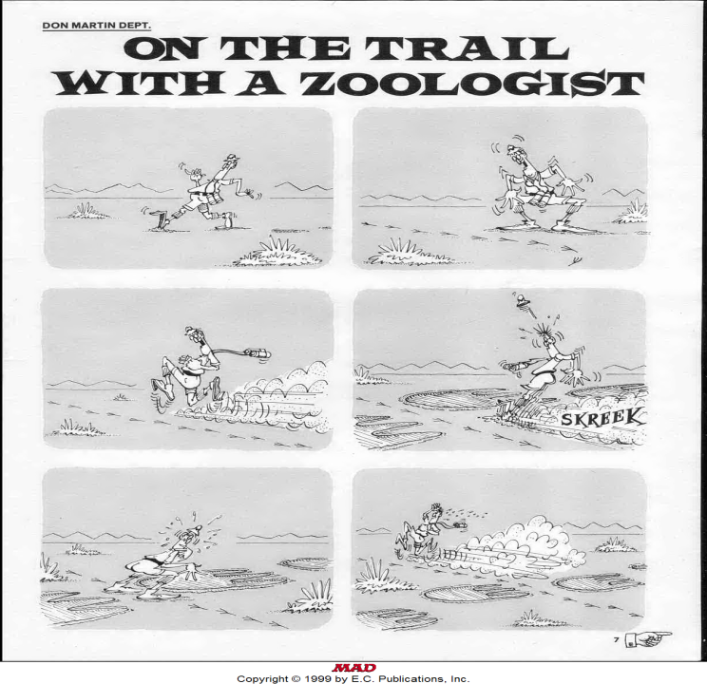

Slide 6
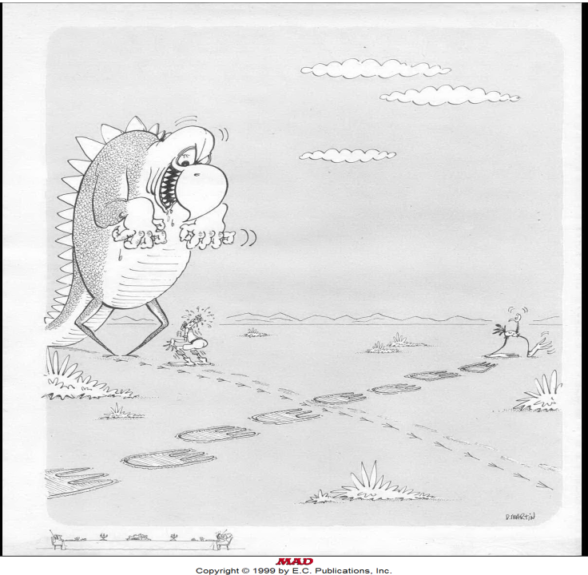
MAD Magazine
1970

Slide 7
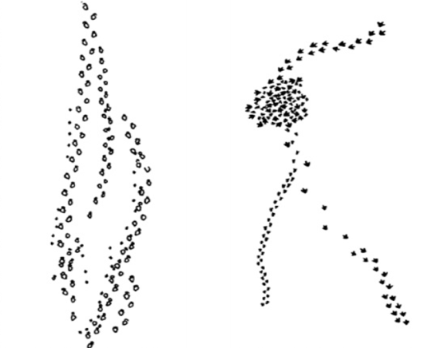
The Footprints Puzzle
Observation or Inference?

Slide 8
1950s “The” scientific method
1960s The processes of science
1970s Scientific inquiry skills
1980s Common themes & habits of mind
1990s The nature of science
2000s The culture of science
2010s Scientific & Engineering practices
2010s Crosscutting concepts
2010s Disciplinary core Ideas

Slide 9
Each epoch of reform in science education tends to recycle the steps and language of “the” scientific method.
Even calls to teach the nature and culture of science all too often dwell upon the imagery of science as a small set of generic processes.
. . . sometimes in a circular fashion:

Slide 11
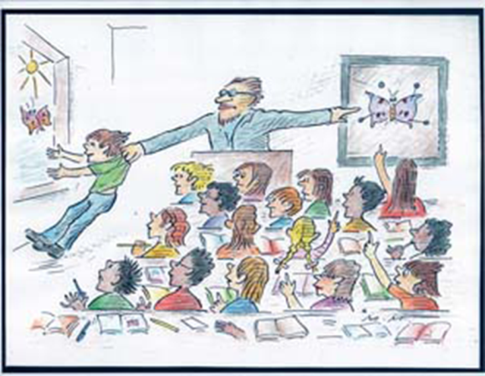
Science Education lacks a “big picture” of itself!
The foundation, the justification, of science in the curriculum is at root a value argument: supporting development of the individual (Rousseau) and promoting societal understanding of science (Huxley).

Slide 12
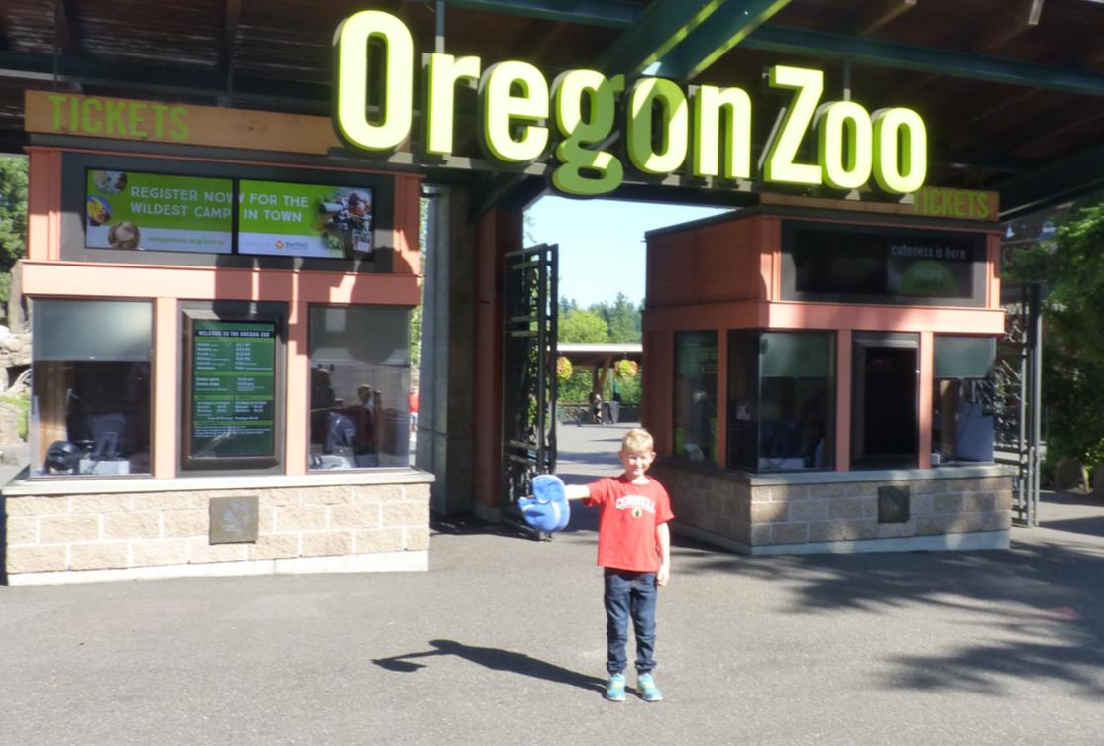
A Lungfish walked into the Zoo, was it you?

Slide 13
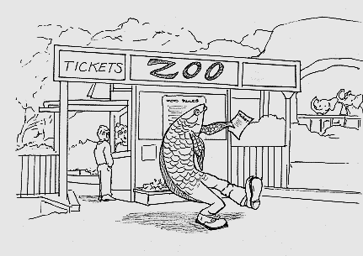
My great, great . . . Great grandparent walks into the zoo!
Interestingly, a distinctly Darwinian conception of how evolution works underpins a great deal of the history of science education: the notion of each of us having “an inner fish” and “an inner reptile”—reflected in the course of our pre-birth development.
Notes:
Refer to Neil Shubin PBS and book

Slide 14
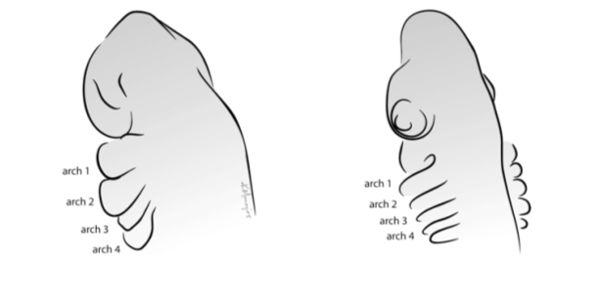
Human
Shark
Similar looking gill regions of embryos during development.
Notes:
Yourinnerfish.com

Slide 15
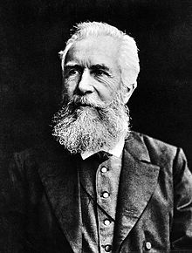
Milepost 1870s-1920s
Ernst Haeckel, Ontogeny Recapitulates Phylogeny
The Biogenetic Law: During development an individual repeats the most important changes in form evolved by its ancestors.

Slide 16
What to recapitulate?
Cultural Epochs Theory: In order to develop properly the child ought to recapitulate the history of society: hunter-gatherers, agriculturalists, Biblical patriarchs, chivalric feudalism, industrial revolution, science and mathematics.

Slide 17
What to recapitulate?
Stages of Cognitive Development: Jean Piaget accepted recapitulation, but argued that the child’s development recapitulated not historical epochs but rather the history of the intellect from sensori-motor reasoning to formal logical operations.
Piaget viewed logical reasoning as an extension of biological adaptation—an advanced stage of development, the adult mind derived from its immature stages.

Slide 18
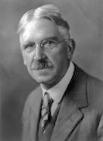
What to recapitulate?
Recapitulating (Experiencing) the Logic of Inquiry: Dewey argued that a student ought to experience (in effect, recapitulate) the logic of action pursued in the course of original inquiry.
For Dewey, the future of civilization depended upon teaching “the scientific habits of mind.”

Slide 19
Dewey’s Scientific Method
1. Feel the difficulty of the situation.
2. Locate and define this difficulty.
3. Suggest possible solutions.
4. Examine the implications of these solutions.
5. Conduct further observation and experiment leading to a solution’s acceptance or rejection.

Slide 20
The Steps of “The” Scientific Method in 2019
Form a question from observation.
Hypothesize an answer.
Design an experiment to test the hypothesis.
Accept or reject the hypothesis based on the analysis of the data.
Propose and test a new hypothesis.

Slide 21
Milepost 1910
John Dewey, Science as Subject-Matter and Method
Dewey's conception of recreating ("recapitulating") the experience of the scientist in the lives of students lies at the heart of decades of reform—
and combines two traditions: Rousseau’s 1700s notion of playful, subject exploration with Huxley’s 1800s conception of methodological unity.

Slide 22
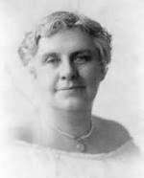
Milepost 1911
*Anna Botsford Comstock, Lesson 106: The Garden Snail, in The Handbook of Nature Study
1. Can the snail pull in one eye and leave the other out?
2. How many spiral turns are there in a snail shell?
3. Place a snail on its back and see how it rights itself.
4. Can you find transparent, glistening snail eggs fastened together by mucuous?
5. Can you find the opening through which the snail breathes?

Slide 23
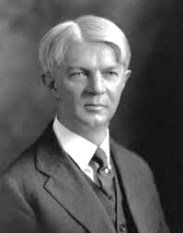
Milepost 1918 William H. Kilpatrick, “The Project Method”
Kilpatrick conceives of the project method broadly as "whole-hearted purposeful activity proceeding in a social environment."

Slide 24
Milepost 1950
Harry S Truman and the National Science Foundation
Science teaching declared an imperative of national security.
Milepost 1957
The Soviet Union launches Sputnik (“fellow-traveler”), reinforcing Truman’s message.
Milepost 1962
*Joseph J. Schwab, in The Teaching of Science as Enquiry
promotes curricula that engage students of all ages in inquiry and discussion; dismisses teaching as a “rhetoric of conclusions.”

Slide 25
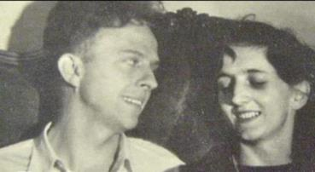
Milepost 1965
*David and Frances Hawkins, Messing About in Science: phases OΔ▢.
Milepost 1967
Robert Karplus and Herbert D. Thier in the Science Curriculum Improvement Study (SCIS)
The Learning Cycle: Exploration of a Concept, Conceptual Invention, Concept Application, the precursor to the 1987 5E model:
Engage, Explore, Explain, Elaborate, Evaluate.

Slide 26
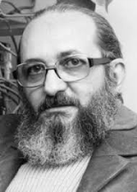
Milepost 1968
Paolo Freire, Pedagogy of the Oppressed
Reflect, through dialogue, and act on the world through education in order to transform it away from dehumanization and towards liberation.

Slide 27
Milepost 1960s-1970s
The “Alphabets”
Science A Process Approach (SAPA), Physical Science Study Committee (PSSC), Biological Science Curriculum Study (BSSC), Elementary Science Study (ESS), Earth Science Curriculum Project (ESCP), Science Curriculum Improvement Study (SCIS), Introductory Physical Science (IPS).

Slide 28
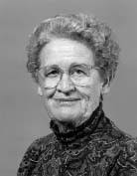
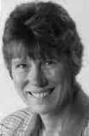
Milepost 1978
*Mary Budd Rowe, Teaching Science as Continuous Inquiry: A Basic shares research on wait time, fate control, language and science in the context of inquiry.
Milepost 1983
*Rosalind Driver, The Pupil as Scientist? questions overemphasis on inductive learning, overemphasis on process skills independent of knowledge about the subject.

Slide 29
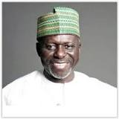
Milepost 1978
John Ogbu, Minority Education and Caste: The American System in Cross-cultural Perspective
Achievement correlated with ethnicity varies by social and depends whether the majority group views them differently. For example, Koreans in Japan are a marginalized group, and their school performance in Japan is significantly lower than in the United States, where their performance is comparable to that of other Asian groups. Similarly, the Burakumin are ethnic Japanese who perform very poorly in Japanese schools, where they are stigmatized, but perform on par with their Japanese and other Asian counterparts in the United States.
Notes:
Text is from Norman and Ault, 2001

Slide 30
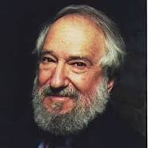
Milepost 1980
Seymour Papert, Mindstorms:
Children, Computers, and Powerful Ideas
Logo programming language for representing geometrical and mathematical concepts makes computational thinking concrete

Slide 31
Milepost 1983
National Commission on Excellence in Education , A Nation at Risk: The Imperative for Educational Reform
America’s enemies seem to have introduced the shortcomings of our schools; standards proposes which became “hijacked” (Dianne Ravitch) by testing.
Milepost 1986
The Holmes Group, Tomorrow’s Teachers
5th year of education for initial teacher certification, create standards of entry to the profession; examinations and educational requirements that are professionally relevant and intellectually defensible.

Slide 32
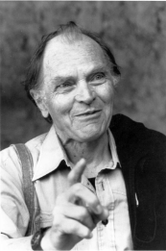
Milepost 1987
Paul K. Feyerabend, Farewell to Reason
Replace scientific rationalism’s quest for certainty with a notion of science that subordinates it the needs of citizens and communities.
Notes:
See Kyle’s South Africa work; tie to Freire

Slide 33
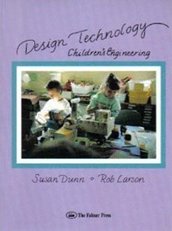
Milepost 1989
Susan Dunn and Rob Larson, Design Technology: Children’s Engineering
Rooted in the tradition of John Dewey and Lev Vygtosky, design technology sets students and teachers to work to construct meaningful objects, such as mechanical toys, that are just beyond the reach of any one child alone. Students working through a cycle of contextualizing,
clarifying, inquiring, planning, realizing,
testing, modifying, interpreting,
reflecting, and back to contextualizing.
Notes:
https://www.renpdx.org/about/ Renaissance School of Arts and Sciences; see also Arbor and DT projects.

Slide 34
Milepost 1995
National Research Council,
National Science Education Standards (NSES)
1. Unifying Concepts and Processes
2. Science as Inquiry Standards
3. Physical Science
4. Life Science
5. Earth and Space Science
6. Science and Technology
7. Science in Personal and Social Perspectives
8. History and Nature of Science Standards

Slide 35
Milepost 1994
United States Congress, Goals 2000 Educate Americans Act
United States students will be first in the world in mathematics and science achievement.
Milepost 2002
United States Congress, No Child Left Behind Act
Mandates “highly qualified teachers” in subject fields.

Slide 36
Milepost 2013
NGSS Lead States, Next Generation Science Standards
Three Dimensional Learning:
8 Scientific Practices 13 Disciplinary Core Ideas 7 Crosscutting Concepts
Plus: 8 Understandings of the Nature of Science

Slide 37
The 8 practices of science and engineering in the NGSS essential for all students to learn are:
Asking questions (for science) and defining problems (for engineering)
Developing and using models
Planning and carrying out investigations
Analyzing and interpreting data
Using mathematics and computational thinking
Constructing explanations (for science) and designing solutions (for engineering)
Engaging in argument from evidence
Obtaining, evaluating, and communicating information
3D

Slide 38
The 13 Core Ideas in 4 Disciplinary Areas
Physical Sciences
1: Matter and its interactions
2: Motion and stability: Forces and interactions
3: Energy
4: Waves and their applications for information transfer
Life Sciences
LS 1: From molecules to organisms: Structures and processes
LS 2: Ecosystems: Interactions, energy, and dynamics
LS 3: Heredity: Inheritance and variation of traits
LS 4: Biological Evolution: Unity and diversity
Earth and Space Sciences
ESS 1: Earth's place in the universe
ESS 2: Earth's systems
ESS 3: Earth and human activity
Engineering, Technology, and the Applications of Science
ETS 1: Engineering design
ETS 2: Links among engineering, technology, science, and society
The NGSS: Another fine mess?
3D

Slide 39
The 7 NGSS crosscutting concepts bridge disciplinary boundaries, uniting the fields of science and engineering. They help students deepen their understanding of the disciplinary core ideas and develop a coherent and scientifically based view of the world.
1. Patterns
2. Cause and effect
3. Scale, proportion, and quantity
4. Systems and system models
5. Energy and matter
6. Structure and function
7. Stability and change
3D

Slide 40
The 8 basic understandings of the Nature of Science in the NGSS
Scientific Investigations Use a Variety of Methods
Scientific Knowledge is Based on Empirical Evidence
Scientific Knowledge is Open to Revision in Light of New Evidence
Scientific Models, Laws, Mechanisms, and Theories Explain Natural Phenomena
Science is a Way of Knowing
Scientific Knowledge Assumes an Order and Consistency in Natural Systems
Science is a Human Endeavor
Science Addresses Questions About the Natural and Material World
3D

Slide 41
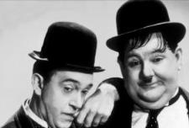
The NGSS call ‘‘for a new [?] approach to teaching science that ties all lessons into the few “big ideas” of science . . . and emphasizes the common practices that scientists use.’’
--Stephen Pruitt, 2013
Vice President, Achieve, Inc.
However, 3-D alignment may risk obscuring how disciplinary ideas integrate thinking and doing in particular contexts.

Slide 42
Milepost 1990
Stephen Toulmin, Cosmopolis:
The Hidden Agenda of Modernity
Collapse of the Quest for Certainty; science understood as justification of the social order.
“Since the 1960s, then, both philosophy and science are back in the
intellectual postures of the last generation before Descartes. In natural
science, the imperial dominion of physics over all other fields has come
to an end: ecologists and anthropologists can now look astronomers and
physicists straight in the eye. In philosophy, Descartes‘ formalist wish-to
refute the skepticism of the Renaissance humanists, by substituting the
abstract demands of logical certainty for their concrete reliance on human
experience-is now seen to have led the enterprise of philosophy into a
dead end. Scientifically and philosophically, that is, we are freed from the
exclusively theoretical agenda of rationalism, and can take up again the
practical issues sidelined by Descartes' coup d'état some 300 years ago.”
(p. 168)

Slide 43
Rather than constituting a single, comprehensive, “unified science,” the sciences are a confederation of enterprises, with methods and patterns of explanation that meet their own distinct problems. “Science” is not a singular noun: instead, the phrase “natural sciences” is plural. The picture of enterprises that are always in flux, and whose methods of inquiry are adapted—as Aristotle taught—to the “nature of the case” ought to replace the Platonist image of a single, formal type of knowledge (Toulmin, 1990).
Notes:
Gallison, Disunity of Science and others in Footprints! Full quote is on Cosmopolis, p. 165.

Slide 44
Darwin's work established the basis for the “historical style” of science, different from the “experimental style.”
--Stephen Jay Gould, 1986
"Evolution and the Triumph of Homology"
Science methods match the demands
characteristic of problems
--S. Toulmin, 1990, Cosmopolis

Slide 45
In order to reform science education, let a search for contexts of value displace the quest to unify the sciences.

Slide 46
Example of a context of value:
Societal preparation, resilience, and recovery in response to geologic hazards, risks, and tragedies
CEETEP – Cascadia Earthscope Earthquake and Tsunami Education Project
http://ceetep.oregonstate.edu/

Slide 47
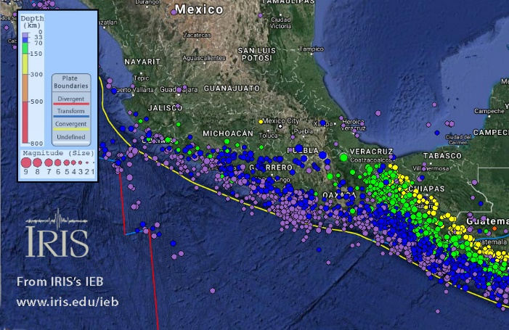
Magnitude 7.1 PUEBLA, MEXICO Tuesday, September 19, 2017 at 18:14:39 UTC
This map of historic seismicity shows shallow earthquakes near the trench and deeper away from the trench. This earthquake is shown by the red star.
Notes:
Explore the seismicity further: Explore in the IRIS Earthquake Browser (www.iris.edu/ieb)

Slide 48
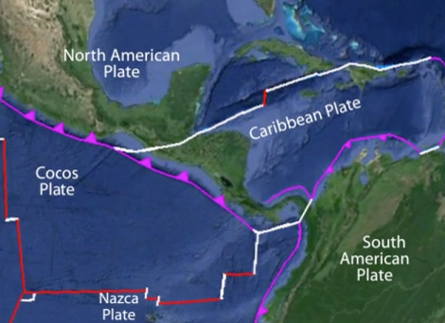
Middle
America Trench
The earthquake was an intraplate event within the top of the Cocos Plate. As oceanic plates descend into subduction zones from the seafloor, they must increase their curvature. This results in extensional forces and earthquakes within the upper plate. The 2001 Nisqually earthquake was similar. That earthquake occurred at 51 km depth beneath the southern Puget Sound in Washington State due to extension within the subducting Juan de Fuca Plate.

Slide 49
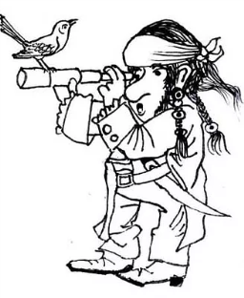
In place of asking, “What are the habits of mind common to all the sciences?”
focus on the question, “How do disciplines respond to the distinct challenges of their respective problems?
Dread Pirate Darwin

Slide 50
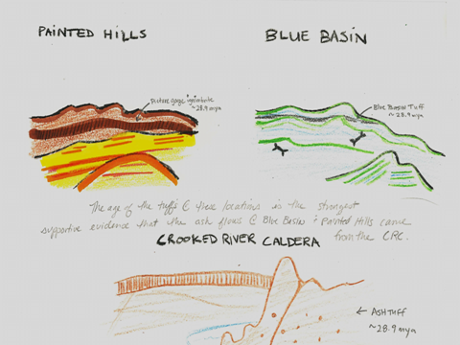
Geology, for example, faces challenges of “scale” and responds with “historical methods” such as “substituting place for time.”

Slide 51
Concept maps depict principles adapted to the challenges of
geologic inquiry.

Slide 52
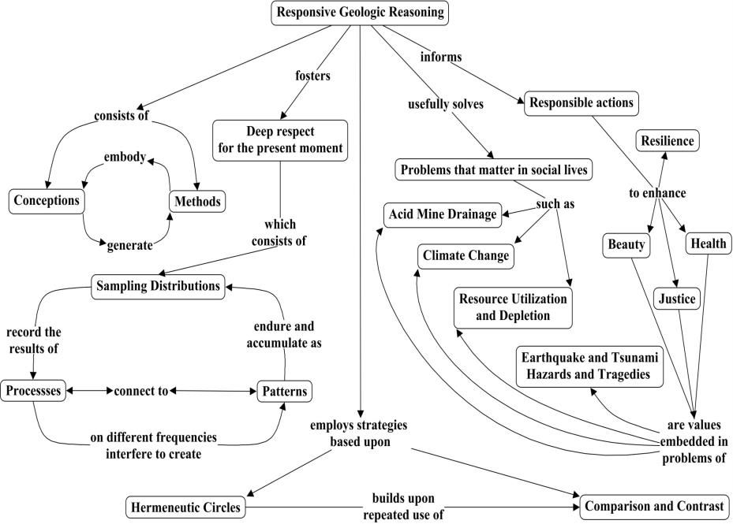

Slide 53
Summary:
Teach how disciplined responses—thinking and doing--adapt to the challenges of inquiry to achieve understanding in contexts of social value and personal interest.

Slide 54
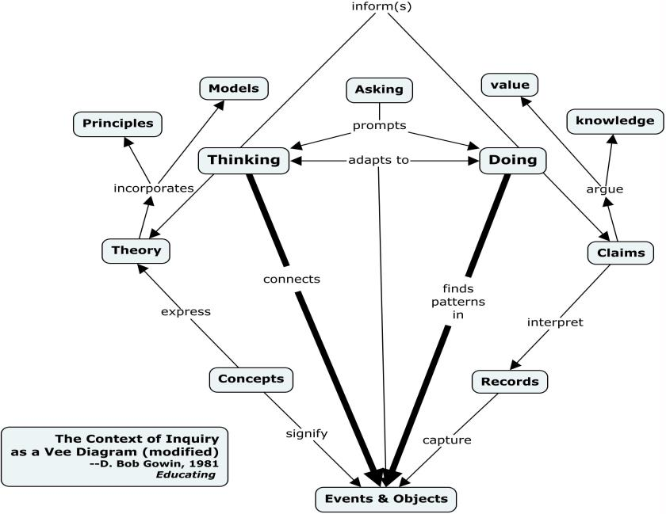

Slide 55
Ask not, “What do all sciences have in common?” but rather: “How do disciplines respond to the distinct challenges of their respective problems?”

Slide 56
Cases of Inquiry
Each discipline responds to its respective challenges: scale in geology, human diversity in medicine, modeling in climate science.

Slide 57
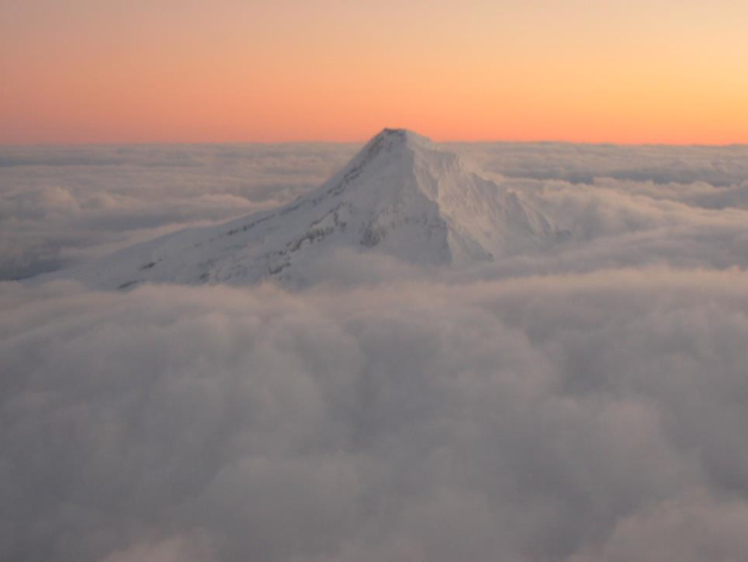
Principles Guiding Geologic Inquiry

Slide 58
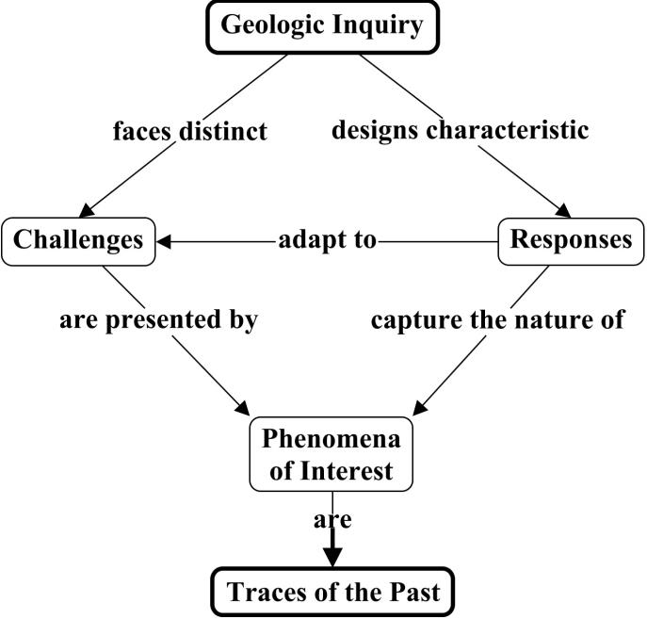

Slide 59
Place often substitutes for time in order to overcome the challenge of vast durations.

Slide 60
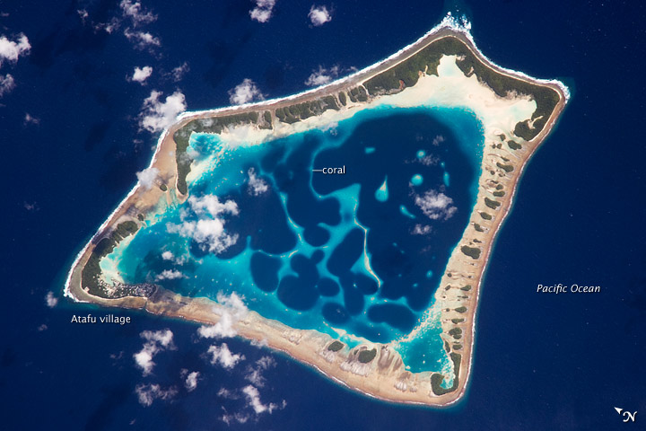

Slide 61
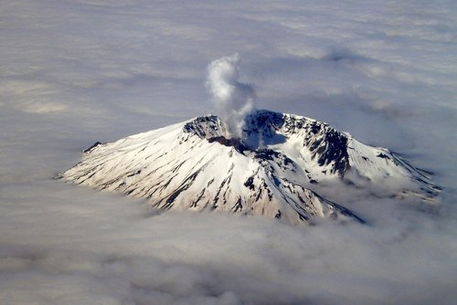

Slide 62
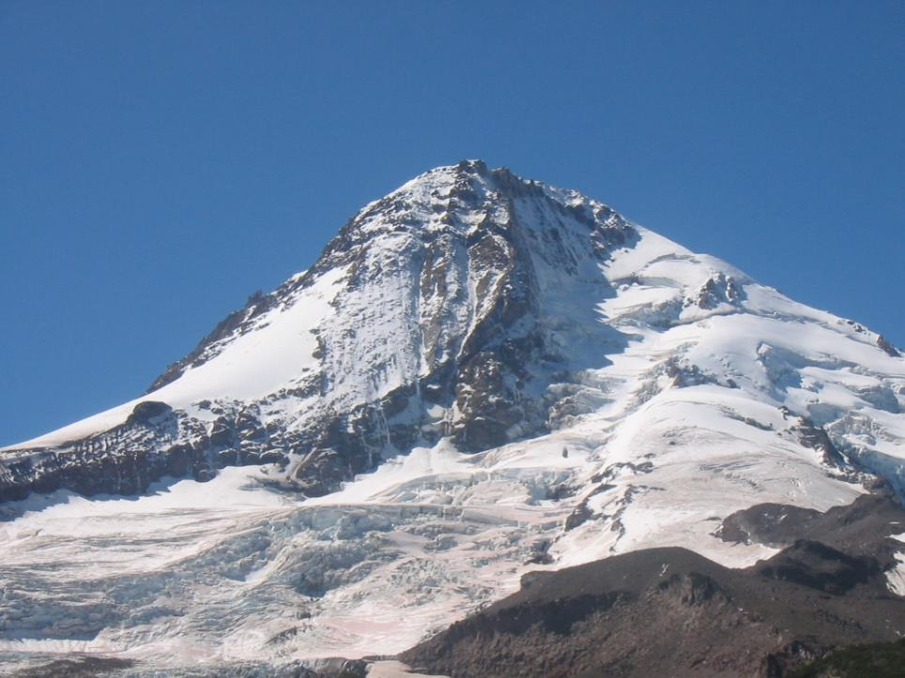

Slide 63
Reconstructing earth stories from traces of the past often invokes modern analogues.

Slide 64
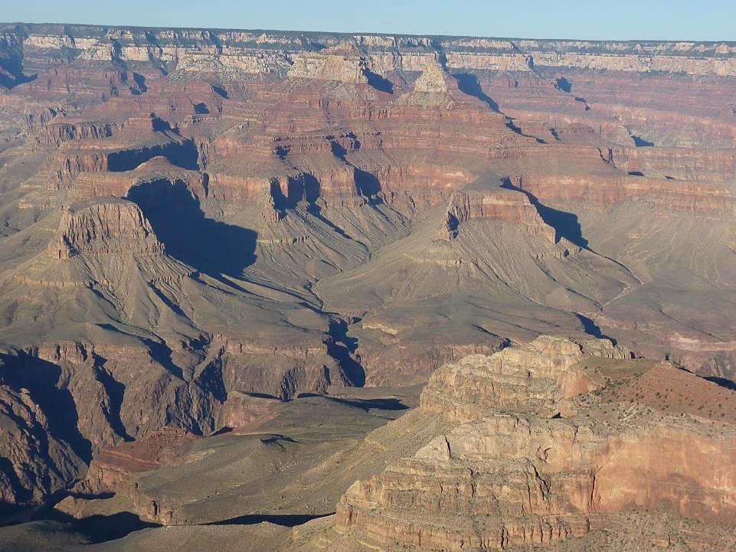

Slide 65
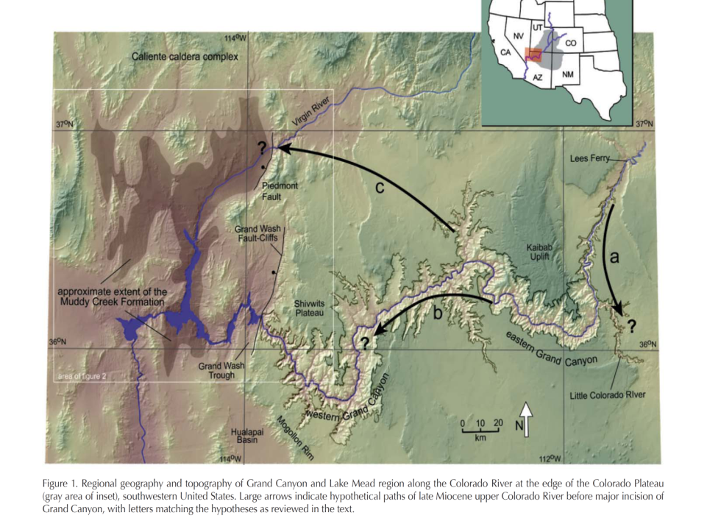

Slide 66
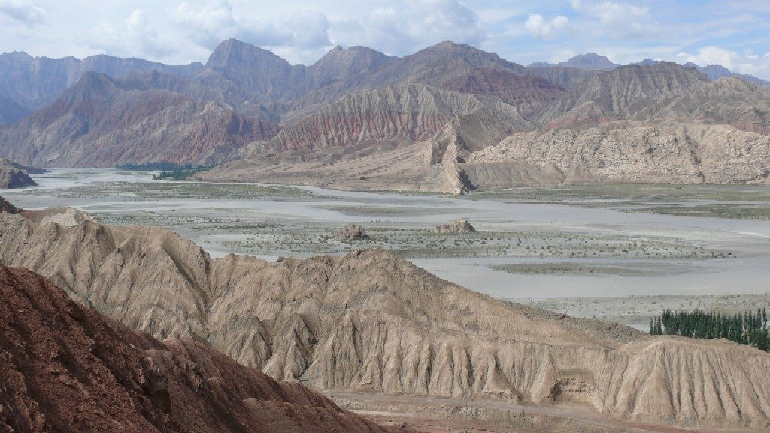

Slide 67
Phenomena of interest have features contingent upon their histories. Category boundaries are “necessarily ambiguous.”

Slide 68
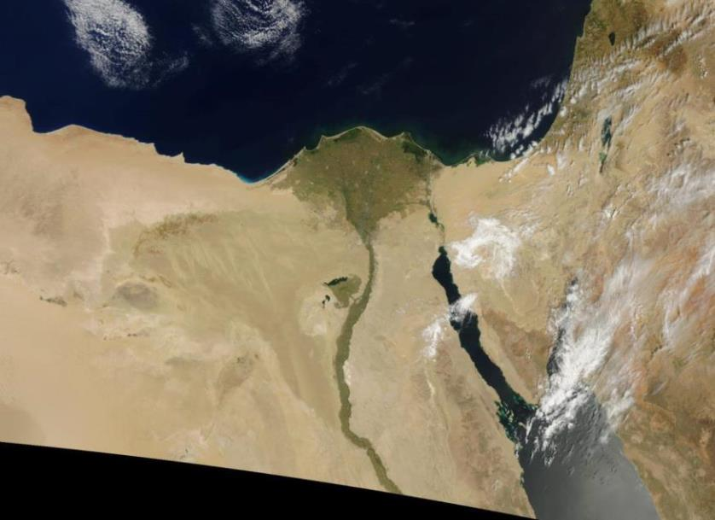

Slide 69
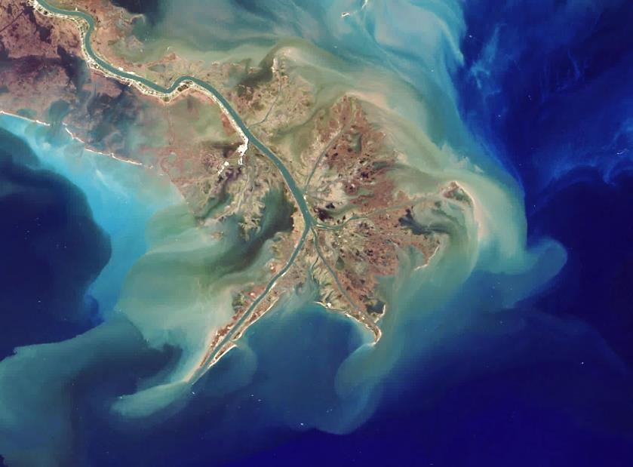

Slide 70
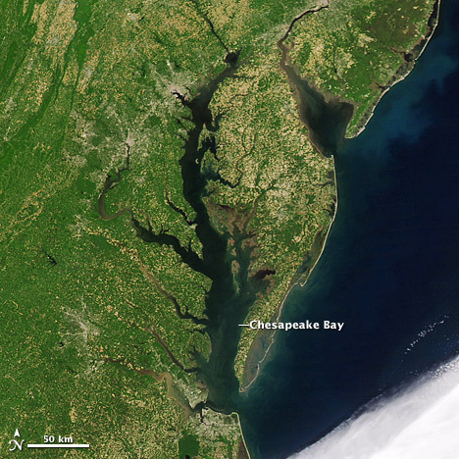

Slide 71
Determining order and synchrony in time is essential to geologic reasoning. Time is the “referee.”

Slide 72
Consider the timing of the Tibetan Plateau uplift. Did raising the plateau cool the earth? Are climate changes synchronized to plateau uplift?

Slide 73
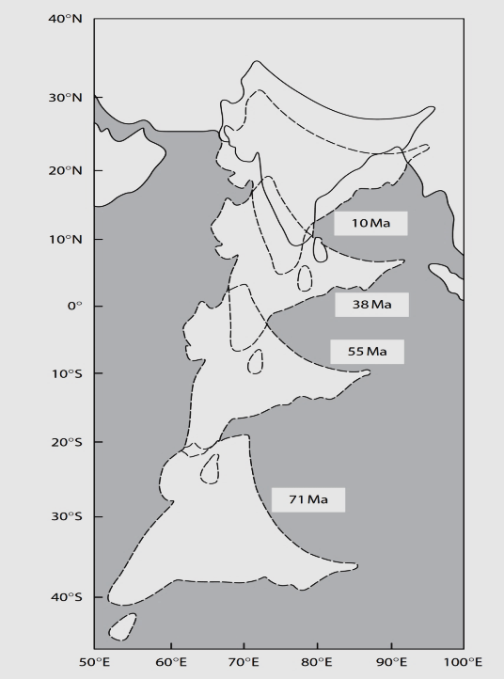

Slide 74
A common cause that resolves puzzling associations among traces of the past often indicates a causal relationship—and changes the context for interpreting interesting phenomena.

Slide 75
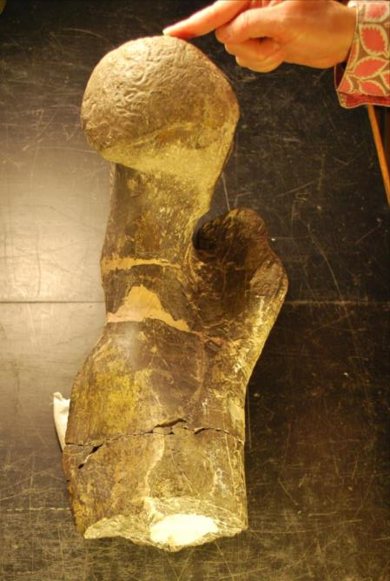

Slide 76
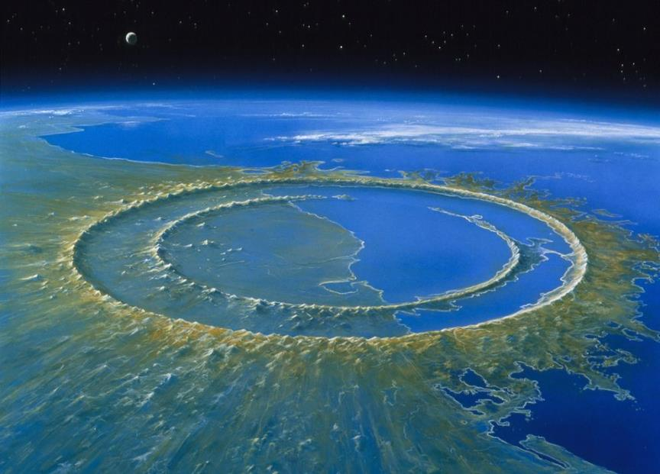
Cretaceous extinction and the iridium anomaly

Slide 77
The reconstruction of earth history from traces of past events utilizes modern analogues, resolves puzzling associations, and depends on temporal logic to adjudicate among competing claims.

Slide 78
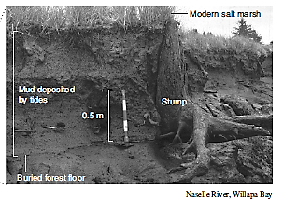

Slide 79
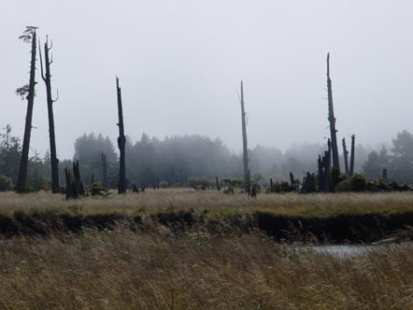
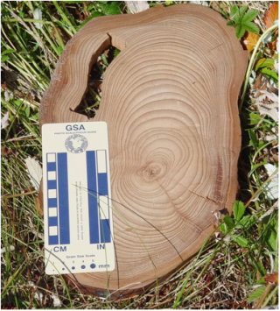
“Ghost Forests” of Coastal Oregon and Washington
Trees in near shore died when the ground dropped and seawater killed the trees. Compare rings from victim trees with rings from witness trees on higher ground. Result: Trees killed between fall 1699 and spring 1700.
Notes:
Tree-ring dating of ghost forests along coastal areas of Cascadia is an important element of the scientific detective work that led to the realization that great earthquakes do occur on the Cascadia subduction zone. The two books listed below tell that story in an engaging and effective way that can be transferred to the Earth Science classroom.
ACTIVITY: On this DVD, a classroom activity on tree-ring dating is provided at: 3. Cascadia Earthquakes & Tsunamis > 2. ACTIVITIES_Cascadia Earthquakes & Tsunamis > Cascadia Tsunami Geology > ACTIVITY Dendrochronology – Tree Ring ACTIVITY
Books on Cascadia great earthquakes and tsunamis:
1. Brian F. ATWATER, MUSUMI-ROKKAKU Satoko, SATAKE Kenji, TSUJI Yoshinobu, UEDA Kazue, and David K. YAMAGUCHI, 2005,
The Orphan Tsunami of 1700—Japanese Clues to a Parent Earthquake in North America; University of Washington Press
2. John Clague, Chris Yorath, Richard Franklin, and Bob Turner, 2006, At Risk: Earthquakes and Tsunamis on the West Coast; Tricouni Press

Slide 80
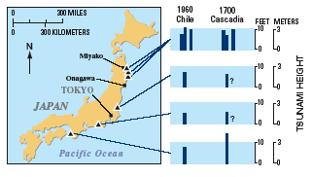
Japanese Tsunami Records
Japanese written records of an “Orphan Tsunami” (tsunami without parent earthquake) in January of 1700 produced by great earthquake on Cascadia subduction zone.
Notes:
Japanese historic records of an “Orphan Tsunami” in January of 1700 document the size and timing of the tsunami that was generated by last great Cascadia earthquake. The Orphan Tsunami of 1700 book provides many examples of these Japanese records.

Slide 81
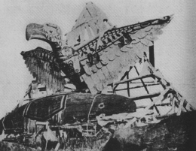
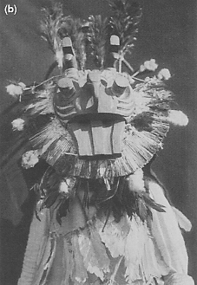
Native American Oral Histories
Oral histories tell of “a great wave that arrived in the night and put the canoes in the trees …”
Notes:
In retrospect, geologists now realize that quite consistent Native American oral histories of earthquakes and tsunamis are passed from generation to generation in Native groups from northern California to western British Columbia. These native stories provide an opportunity to teach about Cascadia earthquakes and tsunamis in a history and social science context.
ACTIVITY: An example of a Native American oral history is described on this DVD at: 3. Cascadia Earthquakes & Tsunamis > 2. ACTIVITIES_Cascadia Earthquakes & Tsunamis > Native American Stories > NativeAmericanOralTradition-PNW Tsunamis.pdf
VIDEO: On this DVD, the Oregon Field Guide Program “Tsunami Update” program includes a segment about Native American oral histories of tsunamis. The video is at: 3. Cascadia Earthquakes & Tsunamis > 2. VIDEOS_Cascadia Earthquakes & Tsunamis > TsunamiUpdate_OregonFieldGuide_OPB.mov
This video can also be viewed online at: http://www.opb.org/programs/ofg/segments/view/1715?q=tsunami

Slide 82
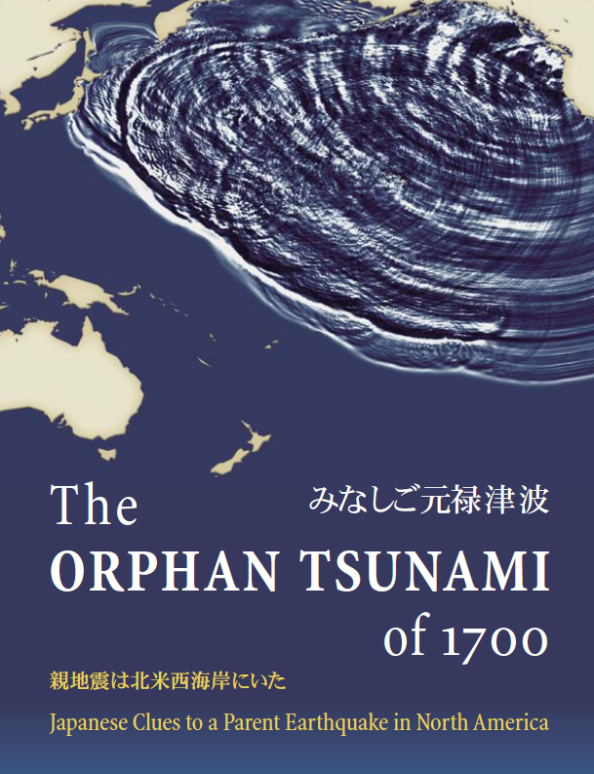

Slide 83
Tōhoku 2011
Cascadia 20??
Interpretation of Ghost Forests and tsunami risk based on thinking thoughts about common cause, time as a referee, and modern analogues.

Slide 84
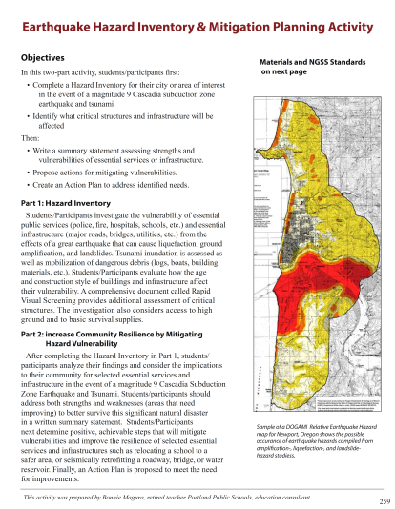

Slide 85
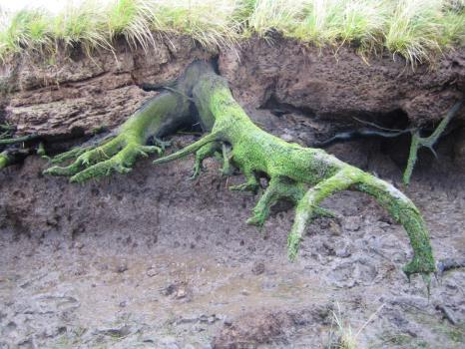
The earth is a text to interpret in a Hermeneutic fashion: context controls the interpretation of the parts; the parts contribute to the understanding of the whole.

Slide 88
Phenomena of interest have features contingent upon their histories. Category boundaries are “necessarily ambiguous.”

Slide 89
Thinking geologic thoughts responds to the challenge of scale, the complexity of earth systems, and the historical nature of the phenomena of interest.

Slide 90
Thinking geologic thoughts stands as an example of what the quest for unity among the sciences obscures:
the dependence of inquiry upon conceptualization serving an explicit purpose within a valued context.

Slide 91
. . . as demonstrated by concept mapping several principles for thinking geologic thoughts adapted to interpreting traces of past events.

Slide 94
Thinking geologic thoughts results in deep respect for
the present moment . . .
Notes:
Rattlesnake Arch, Colorado Plateau, CO Nat. Mon.

Slide 95
and informs the exercise of responsibility for the
future of the Earth.

Slide 96
Conclusion

Slide 97
Science education has yet to embody, in a robust fashion, the pluralist conception of the sciences (i.e., Toulmin’s Cosmopolis) and find within the diversity of the sciences a notion of science that subordinates it the needs of citizens and communities (i.e., Feyeraband’s Farewell to Reason).
Specific humidity in a simulation of Hurricane Katrina making landfall Simulating complex atmospheric phenomena challenges both 21st century science and science teaching.

Slide 98
I urge putting aside the quest for scientific unity—the decadal, generic jargon of method from Huxley to the NGSS—as a defining characteristic of science education.
In the 21st century, asking, “In what ways are the sciences unified?” matters less than “Which sciences, and in what contexts, offer the most value to our social lives and personal interests?”

Slide 99
In order to reform science education, let a search for contexts of value displace the quest to unify the sciences.
Teach disciplinary contributions to understandings in contexts of value.

Slide 100
Thank you!

